Slide 1

In the age of Big Data, what role for Software Engineers?
Tim Menzies
cs, ncstate,
june 2015

Slide 2
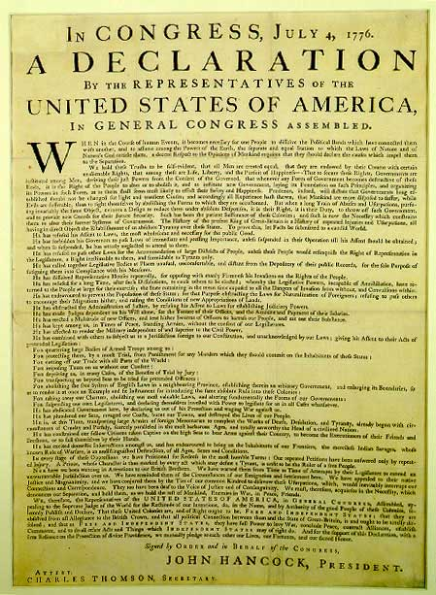

The Declaration of (Human) Dependence
We hold these truths to be self-evident….
Better conclusions =
more data
more cpu
human analysts finding better questions
automatic systems that better understand the questions

Slide 3
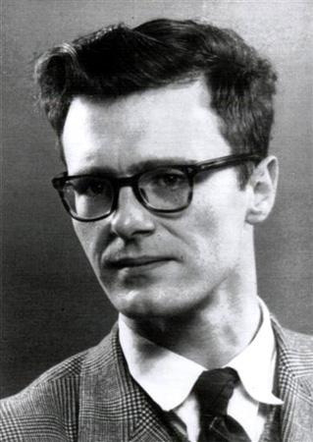
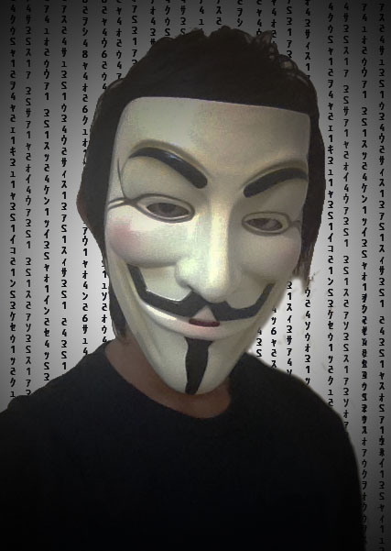
But not everyone agrees
Edsger Dijkstra, ICSE 4, 1979
“The notion of ‘user’ cannot be precisely defined, and therefore has no place in CS or SE.”
Anonymous machine learning researcher, 1986
“Kill all living human experts then resurrect the dead ones”

Slide 4
So what role for SE in the age of Big Data?
Analysis is a “systems” task?
Analysis is a “human” task?
The premise of Big Data:
better conclusions = same algorithms + more data + more cpu
If so, then …
No role for human analysts
All insight is auto-generated from CPUs.
Current results on “software analytics”
A human-intensive process

Slide 5
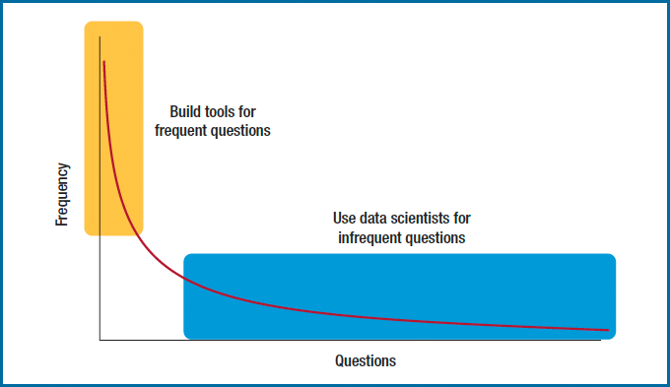
Q: Is Big Data a “Systems” or “Human”-task? A: Yes

Slide 6
This talk: in the age Big Data SE analysts are “goal engineers”
Search-based software engineering
CPU-intensive analysis
Taming the CPU crisis by understanding user goals
Algorithms needs goal-oriented requirements engineering
Goals are a primary design construct
To optimize, find the “landscape of the goals”
Goal-oriented RE need algorithms
Better tools for better explorations of user goals

Slide 7
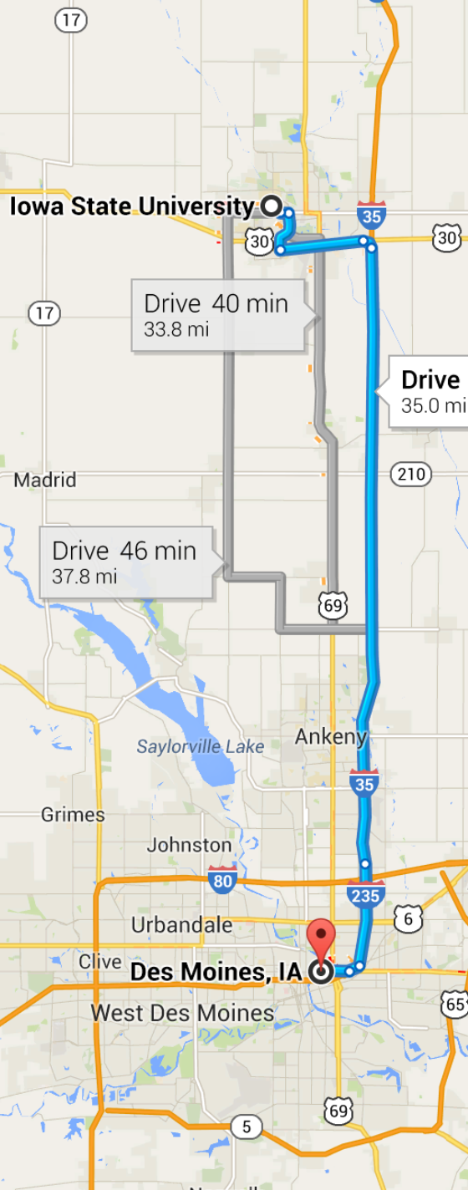
Road map
Define:
“CPU crisis”
“search-based software engineering”
“goal-oriented requirements engineering”
Why more tools? (not enough already)
The power of goal-oriented tools (IBEA)
Feature maps, product-line engineering
Next-gen goal-oriented tools (GALE)
Safety critical analysis cockpit software
Conclusions
Future work

Slide 8


Acknowledgements
SBSE + Feature Maps:
Dr. Abdel Sayyad Salem , Ph.D. WVU 2014
GALE + air traffic control
Dr. Joseph Krall, Ph.D., WVU, 2014

Slide 9
What is…
Goal-oriented requirements engineering?
The CPU crisis?
Search-based software engineering?

Slide 10
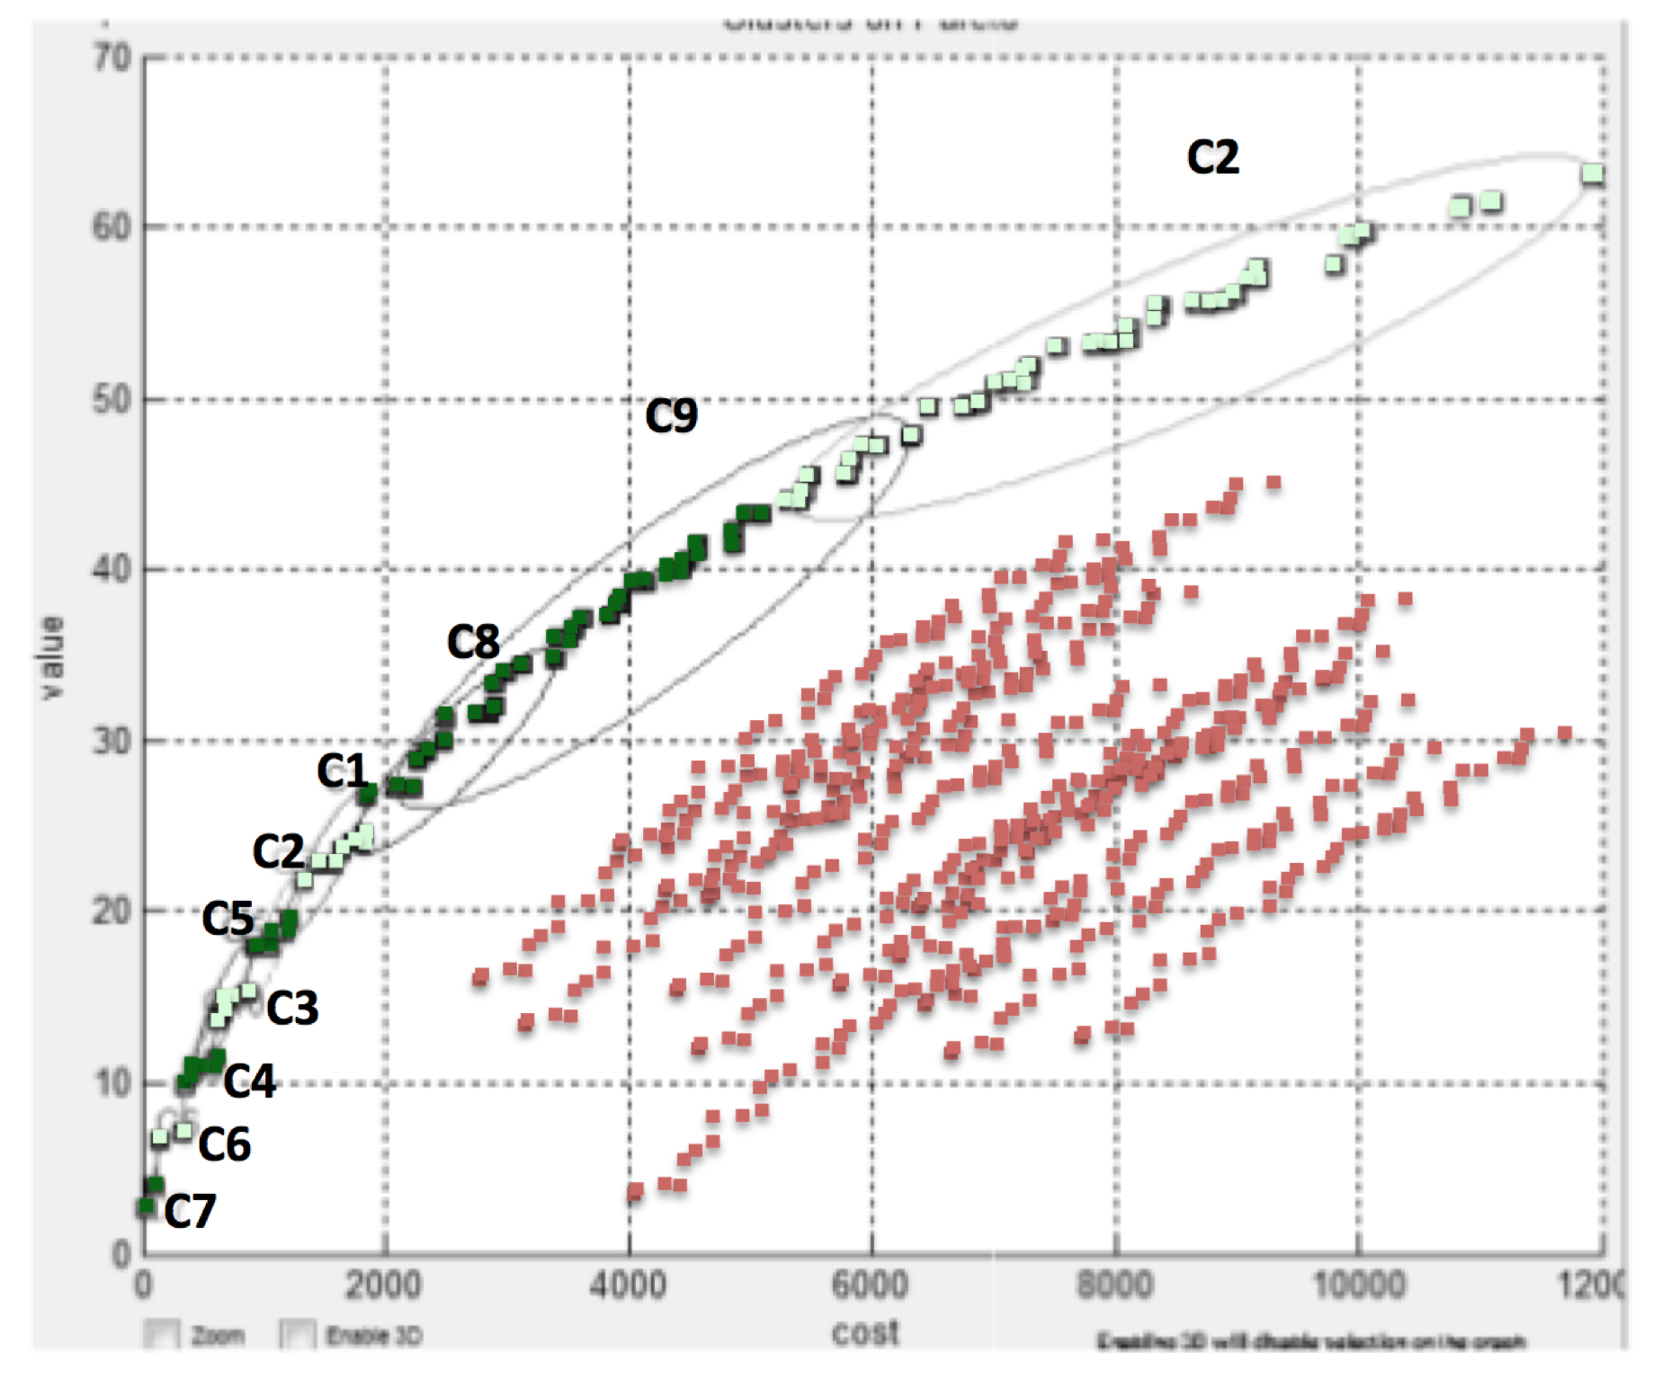
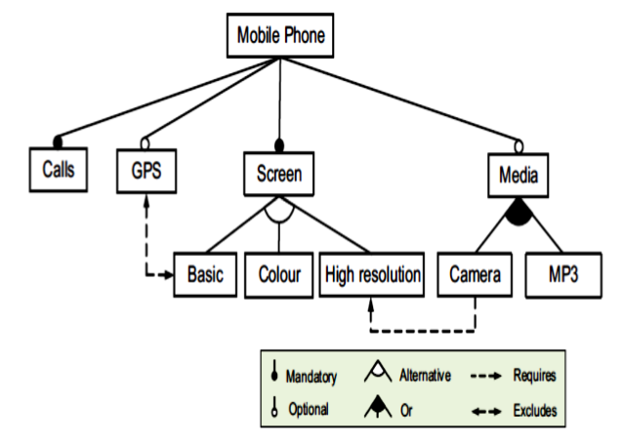
Goal-oriented RE
Axel van Lamsweerde: Goal-Oriented Requirements Engineering: A guides Tour [vanLam RE’01]
Goals capture objectives for the system.
Goal-oriented RE : using goals for eliciting, specifying, documenting, structuring, elaborating, analyzing, negotiating, modifying requirements.
Mostly
manual
✗
✗
Mostly
automatic
✗
✔
Notation- based e.g. UML
Search- based
SE
[Kang’90]

Slide 11
Olde and New style SE
manual software engineering
Model-Based Se
e.g. Full stack DEVLOPs development
engineers laboriously convert (by hand) non-executable paper models into executable code.
Focus of much prior and current work
Engineers codify the current understanding of the domain into a model,
Then study those models
My bet: focus of much future work

Slide 12
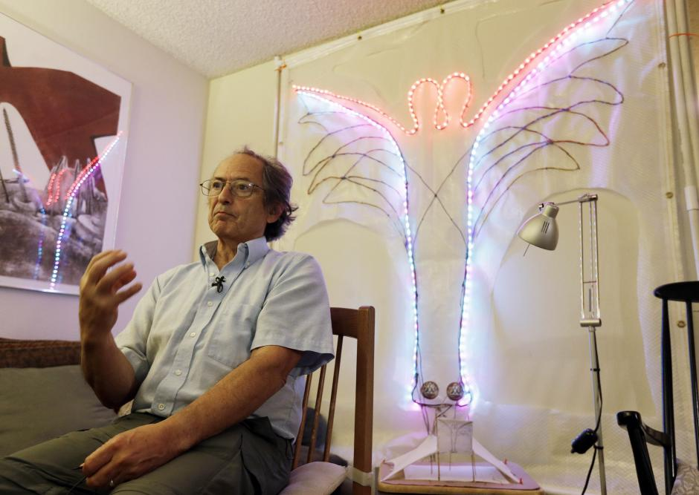
Models: everywhere
Models are now a central tool in scientific research.
in physics, biology and other fields of science
complex simulations using supercomputers.
E.g. genomic map required analyzing 80 trillion bytes
E.g.. Other computational modeling projects
the rise and fall of native cultures,
subnuclear particles
the Big Bang.
Karplus and Levitt
2013 Nobel prize in chemistry
development of multi-scale models for complex chemical systems
Explored complex chemical reactions (e.g. split-second changes of photosynthesis).

Slide 13
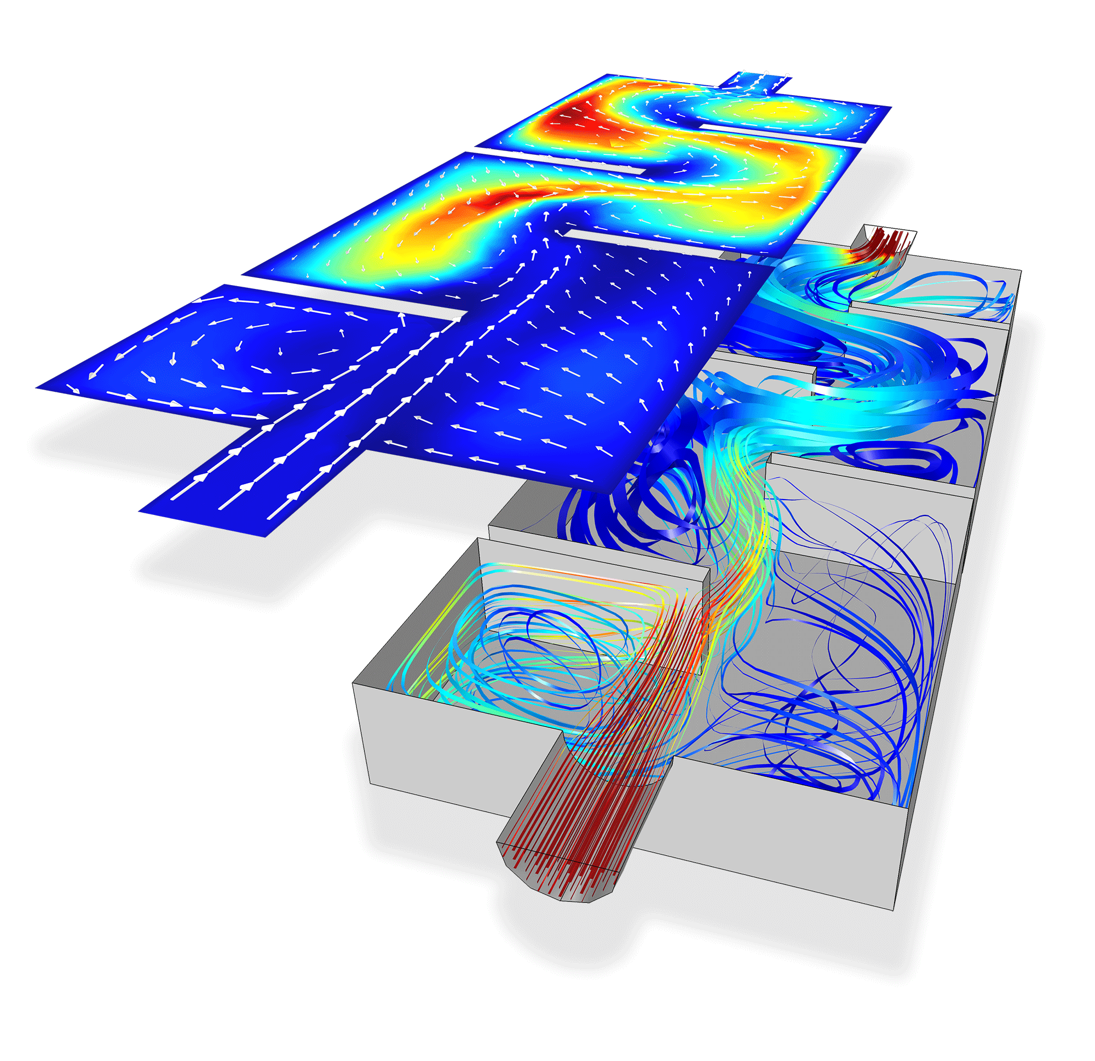
Models: everywhere
If you call an ambulance in London or New York,
those ambulances are controlled by emergency response models.
If you cross the border Arizona to Mexico,
A models determines if you are taken away for extra security measures.
If you default on your car loans,
A model determines when (or if) someone to repossess your car.
If the stock market crashes,
it might be that some model caused the crash.

Slide 14
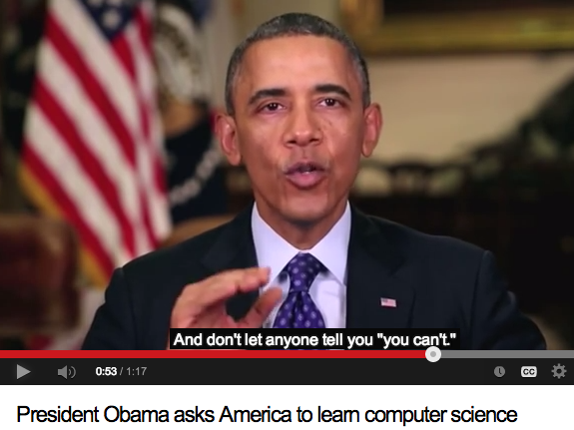
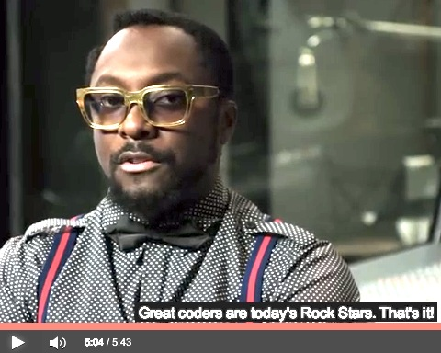
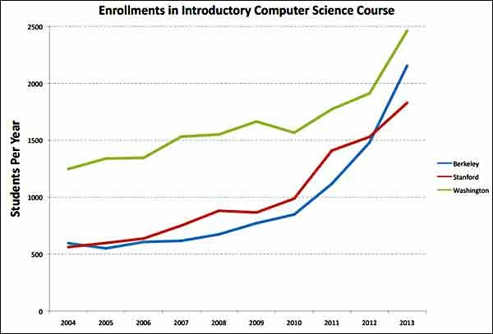
“Big Models”: More and more people writing and running more and more models
http://goo.gl/ljFtX
http://goo.gl/MJuxSt
Great coders are today’s
rock stars. --Will.i.am
2500
Washington
Stanford
Berkeley
500
2004
2009
2013

Slide 15
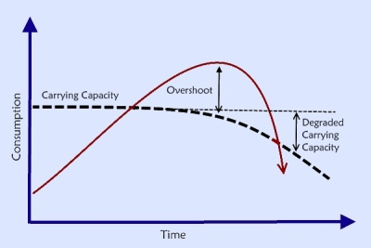
The CPU Crisis
You do the math.
What happens to a resource when
an exponentially increasing number of people ,
make exponentially increasing demands upon it?

Slide 16
To solve the CPU crisis: Don’t Build more CPUS
CPU power requirements (and the pollution associated with generating that power) is now a significant issue.
Data centers consume 1.5% of globally electrical output
This value is predicted to grow dramatically in the very near future.
Google reports that a 1% reduction in CPU requirements saves them millions of dollars in power costs.
Welcome to the age of green software engineering
Moore’s Law’s is over
Power consumption and heat dissipation issues blocks further exponential increases to CPU clock frequencies.
CPU memory access time to extended memory can vary widely.
E.g. For systems on a chip, access time across the bus to the memory of a neighboring chip can be orders of magnitude slower that accessing memory on the local chip.

Slide 17
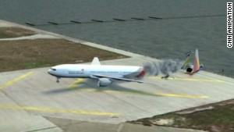
“Big Models” and the CPU crisis: Example #1
Cognitive models of the agents (both pilots and computers)
Late descent,
Unpredicted rerouting,
Different tailwind conditions
Goal: validate operations procedures (are they safe?)
NASA’s analysts want to explore 7000 scenarios.
With current tools (NSGA-II)
300 weeks to complete
Limited access to hardware
Queue of researchers wanting hardware access
Hardware pulled away if in-flight incidents for manned space missions
Asiana Airlines
Flight 214

Slide 18

“Big Models” and the CPU crisis: Example #2
• Very rapid agile software development
• Continually retesting all code
• 4 billion unit tests Jan to Oct 2013
• Welcome to the resource economy.
[Stokely et al. 2009]

Slide 19
Search-based SE (SBSE)
﻿Many SE activities are like optimization problems [Harman,Jones’01].
Due to computational complexity, exact optimization methods can be impractical for large SBSE problems
So researchers and practitioners use metaheuristic search to find near optimal or good-enough solutions.
E.g. simulated annealing [Rosenbluth et al.’53]
E.g. genetic algorithms [Goldberg’79]
E.g. tabu search [Glover86]

Slide 20
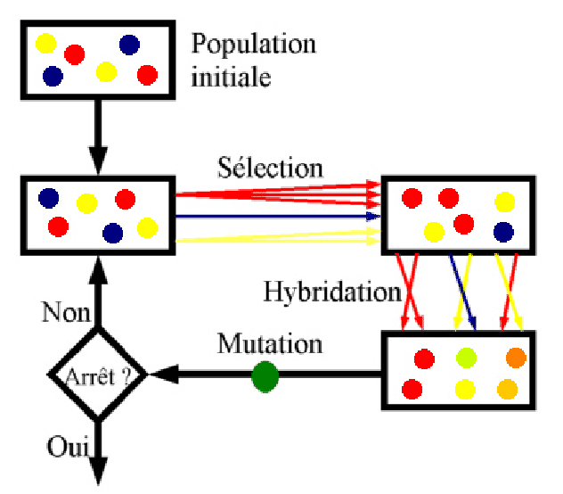
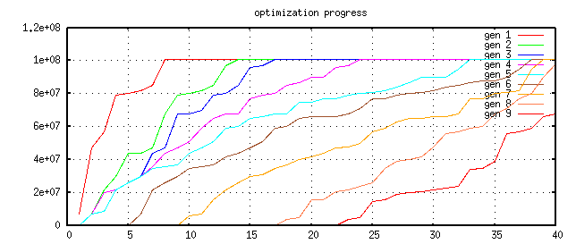
Pareto optimality and evolutionary computing
Repeat till happy or exhausted
Selection (cull the herd)
Cross-over (the rude bit)
Mutation (stochastic jiggle)
Pareto frontier
-- better on some criteria, worse on none
Selection:
-- generation[i+1] comes from Pareto frontier of generation[i]
9
8
7
6
5
4
3
2
1

Slide 21
Applications of SBSE
1. Requirements Menzies, Feather, Bagnall, Mansouri, Zhang
2. Transformation Cooper, Ryan, Schielke, Subramanian, Fatiregun, Williams
3.Effort prediction Aguilar-Ruiz, Burgess, Dolado, Lefley, Shepperd
4. Management Alba, Antoniol, Chicano, Di Pentam Greer, Ruhe
5. Heap allocation Cohen, Kooi, Srisa-an
6. Regression test Li, Yoo, Elbaum, Rothermel, Walcott, Soffa, Kampfhamer
7. SOA Canfora, Di Penta, Esposito, Villani
8. Refactoring Antoniol, Briand, Cinneide, O’Keeffe, Merlo, Seng, Tratt
9. Test Generation Alba, Binkley, Bottaci, Briand, Chicano, Clark, Cohen, Gutjahr, Harrold, Holcombe, Jones, Korel, Pargass, Reformat, Roper, McMinn, Michael, Sthamer, Tracy, Tonella,Xanthakis, Xiao, Wegener, Wilkins
10. Maintenance Antoniol, Lutz, Di Penta, Madhavi, Mancoridis, Mitchell, Swift
11. Model checking Alba, Chicano, Godefroid
12. Probing Cohen, Elbaum
13. UIOs Derderian, Guo, Hierons
14. Comprehension Gold, Li, Mahdavi
15. Protocols Alba, Clark, Jacob, Troya
16. Component sel Baker, Skaliotis, Steinhofel, Yoo
17. Agent Oriented Haas, Peysakhov, Sinclair, Shami, Mancoridis

Slide 22
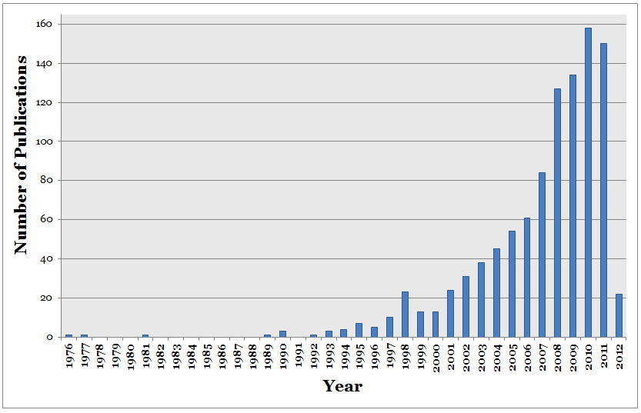
Explosive growth in SBSE
Q: Why?
A: Thanks to Big Data, more access to more cpu.

Slide 23
Why build more tools for SBSE and goal-oriented RE?
(Aren’t there enough already?)

Slide 24
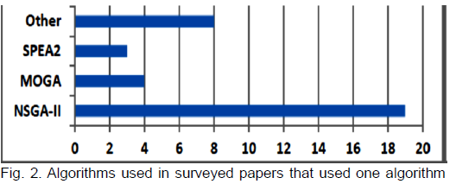
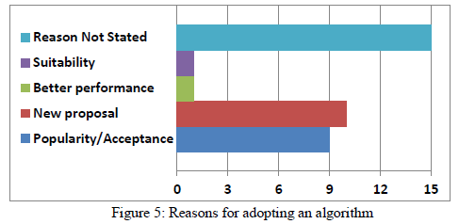
Do we need more SBSE tools for goal-based RE?
mocell
PSO
IBEA
DE
Scatter
search
Spea2
GALE
Nsga-II
SA
Nsga-III
MOEA/D
Z3
SMT solvers

Slide 25
Case study: Feature maps ➔ products
Design product line [Kang’90]
Add in known constraints
E.g. “if we use a camera then we need a high resolution screen”.
Extract products
Find subsets of the product lines that satisfy constraints.
If no constraints, linear time
Otherwise, can defeat state-of-the-art optimizers [Pohl et at, ASE’11] [Sayyad, Menzies ICSE’13].
Cross-Tree
Constraints

Slide 26
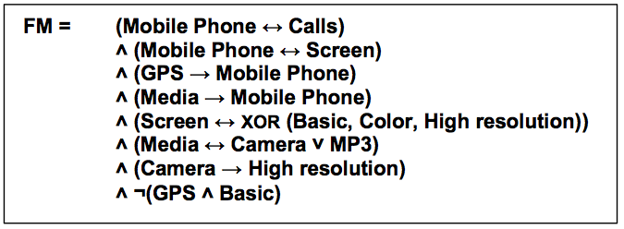
Size of feature maps
This model: 10 features, 8 rules
[www.splot-research.org]: ESHOP: 290 Features, 421 Rules
LINUX kernel variability project
LINUX x86 kernel
6,888 Features; 344,000 Rules
Cross-Tree Constraints

Slide 27
4 studies: 2 or 3 or 4 or 5 goals
Software engineering = navigating the user goals:
Satisfy the most domain constraints (0 ≤ #violations ≤ 100%)
Offers most features
Build “stuff” In least time
That we have used most before
Using features with least known defects
Binary goals= 1,2
Tri-goals= 1,2,3
Quad-goals= 1,2,3,4
Five-goals= 1,2,3,4,5
Abdel Salam Sayyad, Tim Menzies, Hany Ammar: On the value of user preferences in search-based software engineering: a case study in software product lines. ICSE 2013: 492-501

Slide 28
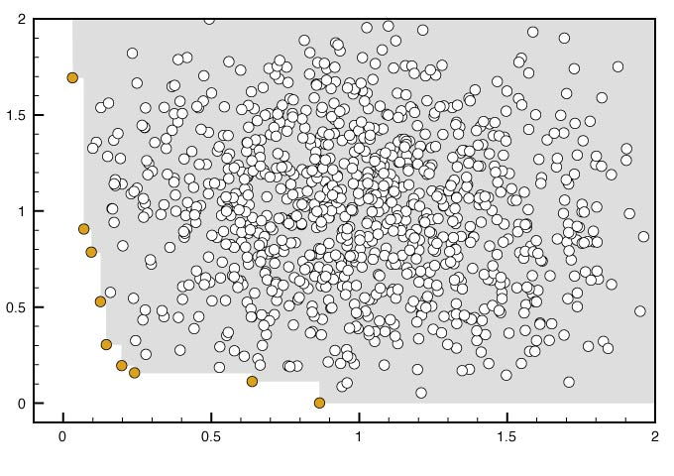
HV = hypervolume of dominated region Spread = coverage of frontier % correct = %constraints satisfied
Example performance criteria
Abdel Salam Sayyad, Tim Menzies, Hany Ammar: On the value of user preferences in search-based software engineering: a case study in software product lines. ICSE 2013: 492-501
Example in bi-goal space Note: example on next slide reports HV, spread for bi, tri, quad, five objective space

Slide 29
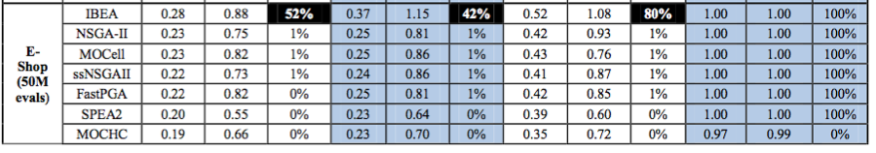
HV = hypervolume of dominated region Spread = coverage of frontier % correct = %constraints satisfied
ESHOP: 290 features, 421 rules [Sayyad, Menzies ICSE’13]
Continuous
dominance
Binary
dominance
Very different, particularly in % correct
Very similar

Slide 30
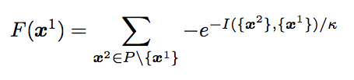
Q: What is so different about IBEA? A: Continuous dominance
[Wagner et.al. 2007]
Discrete
Continuous
Two sets of decisions
One dominates the other if worse on none and better on at least one
Note: returns true,false, not the size of the domination
IBEA : [Zitzler, Kunzli, 2004]
I(x¹,x²):
How much do we have to adjust goal scores such that x¹ dominates x²
Repeat till just a few left
Sort all instances by F
Delete worst
Then, standard GA (cross-over, mutation) on the survivors
time to 100 mph
K= 0.05
heaven
Cost of car

Slide 31
What are the added benefits of goal-oriented reasoning?
Case study: Feature maps for product-line engineering

Slide 32
State of the Art
Features
300,000+
clauses
6888
Single-goal
Multi-goal
Johansen ‘11
Henard ‘12
Sayyad, Menzies’13b
Linux (LVAT)
White ‘07, ‘08, 09a, 09b,
Shi ‘10, Guo ‘11
544
290
Pohl ‘11
Lopez-Herrejon ‘11
Sayyad,
Menzies’13a
SPLOT
Velazco ‘13
Benavides ‘05
9
Objectives

Slide 33
The Seeding Heuristic
Given M < N goals that are hardest to solve
Before running an N-optimization problem:
Seed an initial population by via M-optimization
Study1 (with Z3) :
Optimize for min constraint violations using Z3
Study2 (with IBEA):
Optimize for (a) max features and (b) min violations

Slide 34
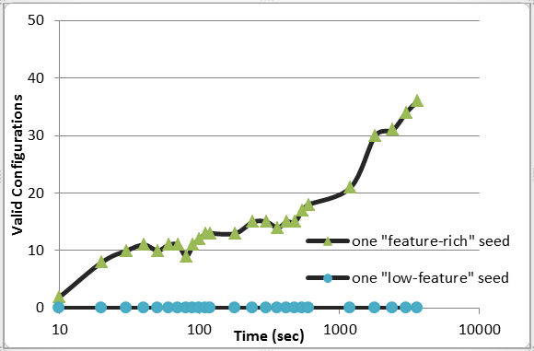
Correct solutions after 30 minutes for the large Linux Kernel model
Abdel Salam Sayyad Joseph Ingram Tim Menzies Hany Ammar,
Scalable Product Line Configuration: A Straw to Break the Camel’s Back , IEEE ASE 2013
5704 of
6888
features
From IBEA
130 of
6888
features
From Z3

Slide 35
How to make goal-based reasoning faster? (GALE = Geometric Active LEarning)
Case study: Safety critical analysis of aviation procedures

Slide 36
WMC: GIT’s Work Models that Compute [Kim’11]
Cognitive models of the agents (both pilots and computers)
Late descent,
Unpredicted rerouting,
Different tailwind conditions
Goal: validate operations procedures (are they safe?)
NASA’s analysts want to explore 7000 scenarios.
With current tools (NSGA-II)
300 weeks to complete
Limited access to hardware
Queue of researchers wanting hardware access
Hardware pulled away if in-flight incidents for manned space missions
Asiana Airlines
Flight 214

Slide 37
Active learning and evolutionary computing
Repeat till happy or exhausted
Selection (cull the herd)
Cross-over (the rude bit)
Mutation (stochastic jiggle)
Naïve selection
• score every candidate Active learning • Score only the most informative candidates • e.g. just score most distant points in data
clusters

Slide 38
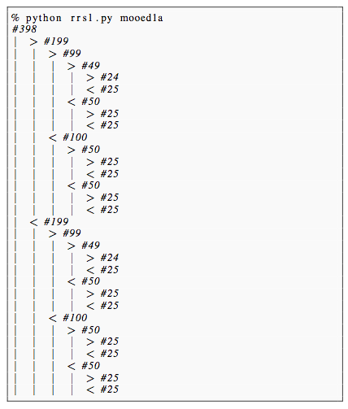
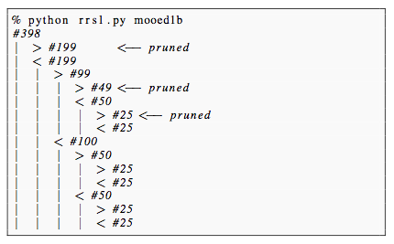
Recursively cluster data, find most distant points in leaf clusters
e.g. 398 cars
Maximize acceleration,
Maximize mpg
Find splits using FASTMAP O(n) [Faloutsos & Lin ’95]
At each level only check for dominance of two most extreme points
2log₂(N) evals, or less
Leaves = non-dominated examples (i.e. the Pareto frontier)
14 evaluations
of goals

Slide 39
For frontier as convex hull, for each line segment, push towards best end
• utopia
Given goals u, v, …
utopia = best values
hell = furthest from utopia
All distances normalized 0..1
Given a line east to west
s1 = I(east, hell)
s2 = I(west, hell), s2 > s1
C = dist(west,east)
p = push on line east,west
direction = towards better (west)
magnitude[i]=
D= west[i] – east[i]
new = old + old * C * D
Reject if over C*1.5
v
east
s1
west
s2
hell •
u
v
p
hell •
u
v
hell •
u

Slide 40
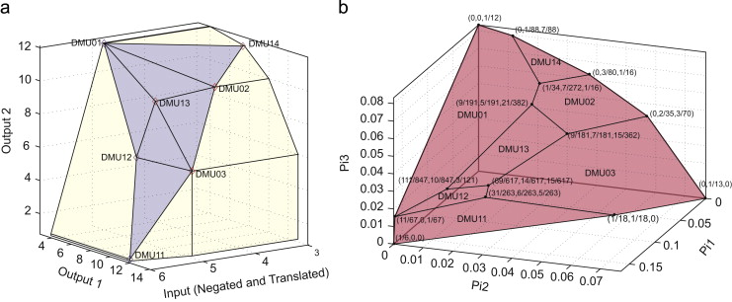
Repeat for all points on line segments on non-dominated region of convex hull
GALE:
Population[ 0 ] = N random points
Find M points on local Pareto frontier (approximated as convex hull)
Mutants = mutate M over line segments on hull
Population[ i+1 ] = Mutants + (N – #Mutants) random points
Goto 2
Related work: [Zuluaga et al. ICML’13]

Slide 41
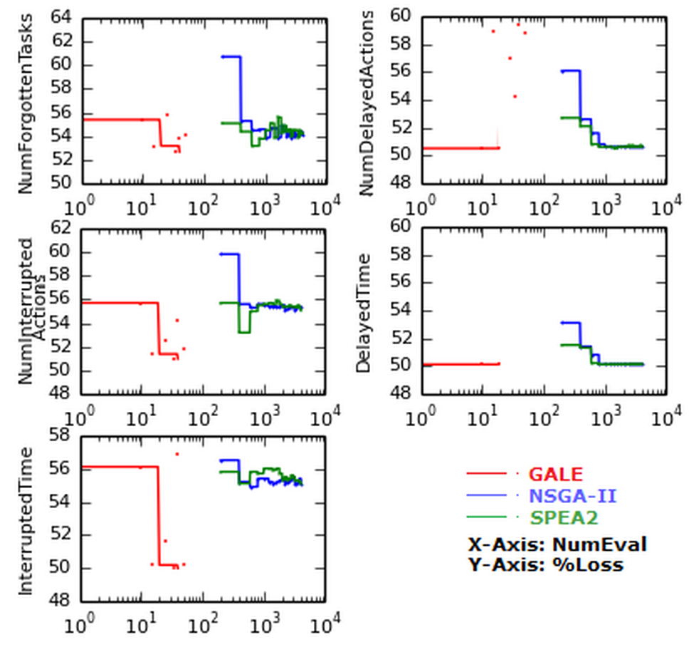
Results on NASA models: Scores as good as other methods Orders of magnitude fewer evaluations
4 mins (GALE) vs 7 hours (rest)
#forgotten tasks
#interrupted acts
Interruption time
1
4
#delayed acts
Delay time
1
4
2
5
3
"Better Model-Based Analysis of Human Factors for Safe Aircraft Approach”
Krall, Joe; Menzies, Tim; Davies, Misty
IEEE Transactions on Human-Machine Systems, to appear 2015
2
5
3

Slide 42
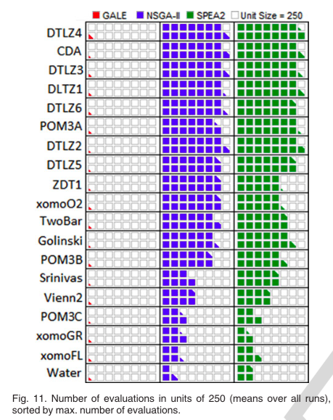
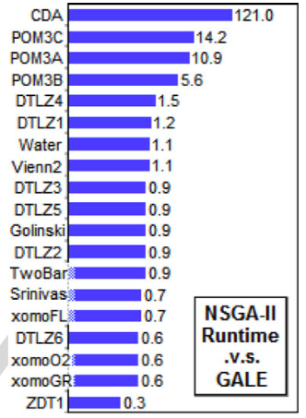
Runtimes,
Number of evaluations
GALE: Geometric Active Learning for Search-Based Software Engineering ,
IEEE TSE, 2015, to appear
Joseph Krall, Tim Menzies, and Misty Davies

Slide 43
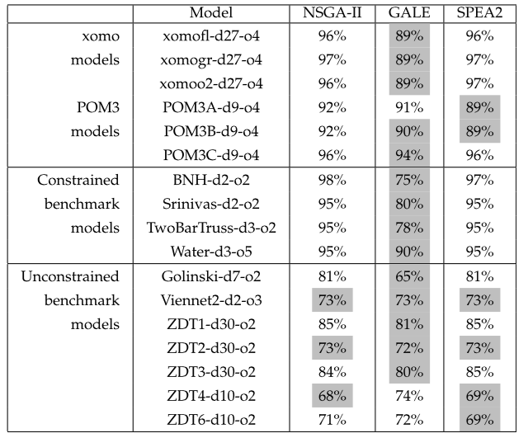
Minimizations of objective scores
gray
Significantly different (Mann Whitney, 95%) and least
GALE: Geometric Active Learning for Search-Based Software Engineering ,
IEEE TSE, 2015, to appear
Joseph Krall, Tim Menzies, and Misty Davies

Slide 44
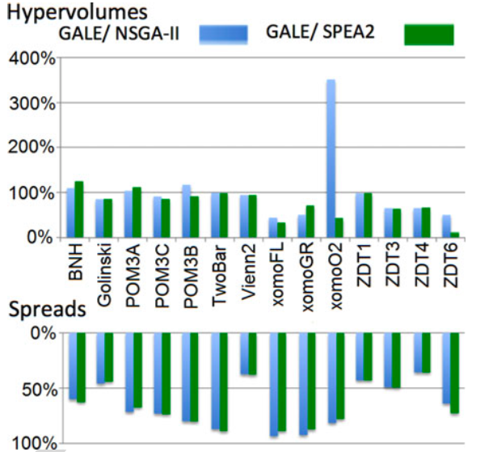
GALE’s search: A more thorough search of a smaller volume
GALE: Geometric Active Learning for Search-Based Software Engineering ,
IEEE TSE, 2015, to appear
Joseph Krall, Tim Menzies, and Misty Davies
Less
hypervolume
Better
spread

Slide 45
Conclusion

Slide 46
The CPU Crisis
You do the math.
What happens to a resource when
an exponentially increasing number of people ,
make exponentially increasing demands apon it?

Slide 47
To manage the CPU crisis: need a better understanding of the “shape” of the user goals
Domination
Is a binary
concept
PSO
IBEA
Aggressive
exploration
of preference
space
DE
Scatter
search
GALE
Spea2
Nsga-III
TAR
Nsga-II
SA
MOEA/D
WHICH
mocell
Z3
SMT solvers

Slide 48
Q: In the age of Big Data, what role for Software Engineers? A: Goal Engineering
Search-based software engineering
CPU-intensive analysis
Taming the CPU crisis by understanding user goals
Algorithms needs goal-oriented requirements engineering
Goals are a primary design construct
To optimize, find the “landscape of the goals”
Goal-oriented RE need algorithms
Better tools for better explorations of user goals

Slide 49
GALE : A toolkit for UNDERSTANDING THE SHAPE of GOAL SPACE
An optimization algorithm
A data miner
A visualization tool
A requirements negotiation tool
A compression algorithm
summarize interesting regions of complex space
An anomaly detector
The story thus far
Data exchange tool for agents
Share least data with most value
A comment on the paradoxical success of beings as confused as humans
seemingly complex problems, aren’t

Slide 50
Analysis = humans + systems
better conclusions =
more data
more cpu
human analysts finding better questions
automatic systems that better understand the questions

Slide 51
Combining algorithms and goal-oriented RE
Edsger Dijkstra, ICSE 4, 1979
Tim Menzies, 2015
“The notion of ‘user’ cannot be precisely defined, and therefore has no place in CS or SE.”
Mathematical definition of “user”
“The force that changes the geometry of search space.”

Slide 52


